Slide 1



SEID 2364: Societal and Ethical Impact of Data Science
MODUL UNIVERSITY VIENNA
SESSION 4
Frameworks
David B. Smith
Notes:
We are going to take the education adventure together. We are going to marco, and go micro, and we are going to see why MU is the right place for you. Lets begin.

Slide 2
Opening Provocations
Write in your private journal
Stream of consciousness.
Capture your immediate intuition, not a polished or argued answer.
Do not analyze or justify.
Words or short phrases are enough.
Notes:
(Write. Do not discuss yet.)

Slide 3
Provocation
When no option avoids harm, what does it mean to choose the “right” action?

Slide 4
Provocation
Provide an example where two people arrive at different—but defensible—evaluations of harm in the same situation.

Slide 5
Provocation
What different ways might people decide between competing harms?

Slide 6
Today’s Plan
workflow (GitHub + Zotero)
how we make decisions about harm
Build toward structured decision-making (frameworks)

Slide 7
Workflow Integration
GitHub → structure and presentation
Zotero → research and citation

Slide 8
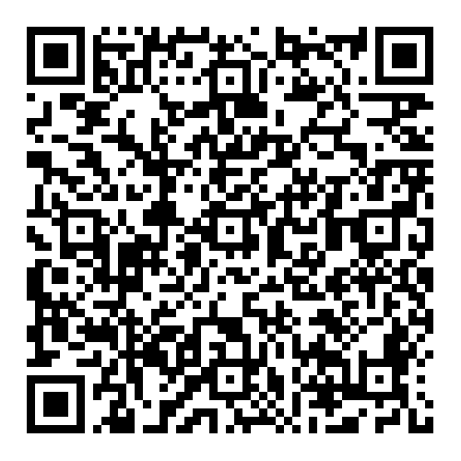
GitHub Repository folder
GitHub Assignment Link
In‑Class GitHub Tasks
Convert Assignment 3 to Markdown (harm-analysis.md) and upload it to your folder
Create README.md with your current definitions of Ethics, Intelligence, and Harm
Commit and push both files to your personal branch

Slide 9
Zotero – Add a Citation.
In‑Class Zotero Task
Add one scholarly or credible source related to harm to the shared Zotero library
Create your own Zotero collection to organize sources for your emerging research project
Ensure the citation is complete (metadata + link or attachment)

Slide 10
Return to Your Responses
We will now examine how we made our decisions.

Slide 11
Scenario Extraction
Use a scenario from your Week 3 Harm Analysis
Or use a provocation scenario
Reduce to a short label

Slide 12
WHITE BOARD LAYOUT
Whiteboard Activity (3 Columns)
1. Scenario | 2. Harm | 3. Decision
System & actors | Types of harm | Core dilemma
Decision point | Stakeholders | Trade-off
 | Conflicts | X vs Y

Slide 13
Reasoning Examples
Minimize total harm
Do not intentionally harm
Foreseeability matters

Slide 14
Points of Tension
Individual vs societal harm
Certainty vs probability
Responsibility assignment
Quantifying Harm

Slide 15
Question
Are we comparing different kinds of harm, or the same harm applied to different people?

Slide 16
Extending the Scenario: Multi-factor harm
Death vs injury
Immediate harm vs long-term societal trust
Individual harm vs systemic impact

Slide 17

Key Shift
From: Who is harmed?
To: What kinds of harm are being compared?

Slide 18

Instability
Different people → different answers Same situation → different evaluations

Slide 19
Question
If two people can justify different decisions, what does that suggest about how we are deciding?

Slide 20
Problem
If decisions rely only on individual judgment, outcomes may be inconsistent

Slide 21
Transition
We need a way to make decisions more consistent

Slide 22
Framework Systems
A framework system is useful only if it can…

Slide 23
Possible Criteria
Consistency
Clarity
Fairness
Applicability
Justification

Slide 24
The Assessment Problem
How do we know if a framework actually satisfies these conditions?

Slide 25
Example Focus: Fairness
If a system claims to be fair, how would we determine that?

Slide 26
Harm Types
Physical
Economic
Psychological
Social
Reputational
Temporal

Slide 27
Scope of Harm
Individual
Societal / System-level

Slide 28
The Comparison Problem
How do we compare different types of harm?

Slide 29
Examples
Physical injury vs financial loss
Individual vs societal harm
Immediate vs delayed harm

Slide 30
Key Insight
Harms are not directly comparable

Slide 31
Implication
Comparison requires a system, not intuition

Slide 32
System Requirements
Identify parameters
Measure magnitude
Compare across types
Account for scope
Determine weighting

Slide 33
Question
Can harm to a group justify harm to an individual?

Slide 34
Frameworks Exist
Different systems solve these problems in different ways

Slide 35

Consequentialism
Ethical value depends on the magnitude and distribution of harms and benefits produced by an action.
Notes:
Focus: outcomes Source: Utilitarian tradition (Jeremy Bentham, John Stuart Mill)
Assessment Mechanism:
- Define outcome metrics (types of harm)
- Estimate probabilities and magnitudes - Aggregate (sum/expected value) across stakeholders - Sensitivity to weighting assumptions - Check for omitted harms (indirect, long-term, distributional)

Slide 36
Deontology
Ethical value depends on rule compliance, not harm minimization.
Notes:
Focus: rules and constraints Source: Kantian ethics (Immanuel Kant) Assessment Mechanism:
Identify applicable rules/rights/duties
- Test for violations (hard constraints)
- Evaluate universality/consistency of maxims
- Prioritize constraints over outcomes when in conflict
- Check for edge cases and rule conflicts (exceptions, thresholds)

Slide 37
Virtue Ethics
Ethical value depends on judgment and character, not calculable rules or outcomes.
Notes:
Focus: judgment and character
Source: Classical Greek philosophy (Aristotle)
Assessment Mechanism: - Identify relevant virtues (e.g., justice, prudence) - Evaluate context-sensitive judgment (phronesis) - Compare actions to exemplar agents - Balance competing virtues (no fixed weighting) - Check for blind spots (bias, cultural variance, lack of codified rules)

Slide 38
Application
Different frameworks produce different answers

Slide 39
Key Idea
The goal is not agreement, but structured reasoning

Slide 40
Assignment Preview
You will investigate and test a framework

Slide 41
Assignment Components
Select a scenario (from Week 3 or class board)
Identify types of harm
Research one framework (source + principles)
Apply the framework to the scenario
Test weighting across harm types
Evaluate outcomes and limitations

Slide 42
Closing
Different systems → different answers Structured reasoning matters

